Slide 1
Intelligent saving Drone
Artificial intelligent powered surveillance drone

Slide 2
How does it works ?
Saving drone is powered with a deep learning computer vision algorithm called convolutional neural network.
Which is able to recognize suspicious armed men, areas in chaos or riot and notified the nearest arm force agents base to take keep action.
Saving drone will assist Nigeria arm force in missions or locating a target (wanted)

Slide 3
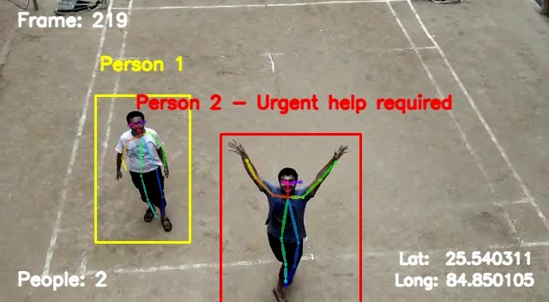
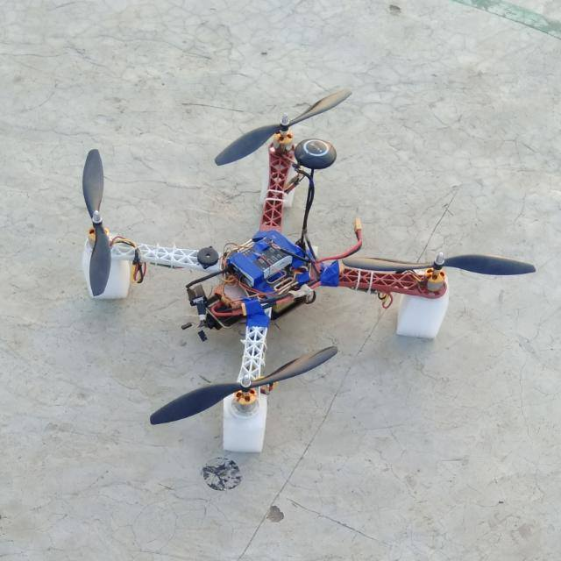

Slide 4
Demo

